Slide 1





Presented by :- Rohit Kumar Mishra
Challenge 4
Aatliq Hardware
Consumer Goods
Ad-Hoc Insights

Slide 2



1
Contents:-
2
Atliq’s schema
Ad-Hoc Request, Queries,
Visualization & Insights

Slide 3

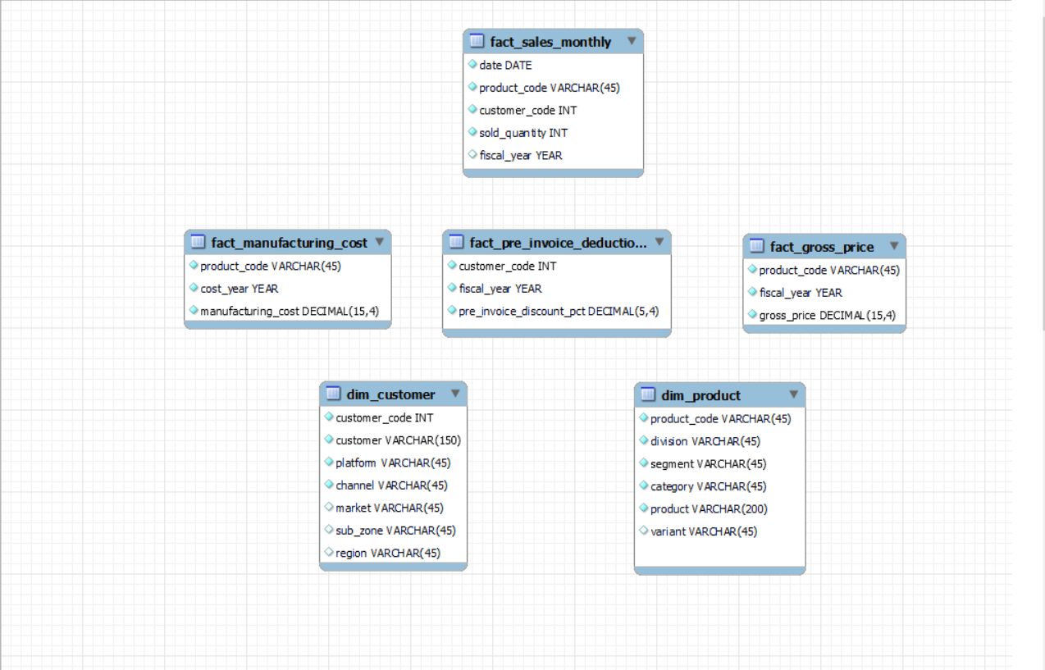
Atliq’s schema

Slide 4


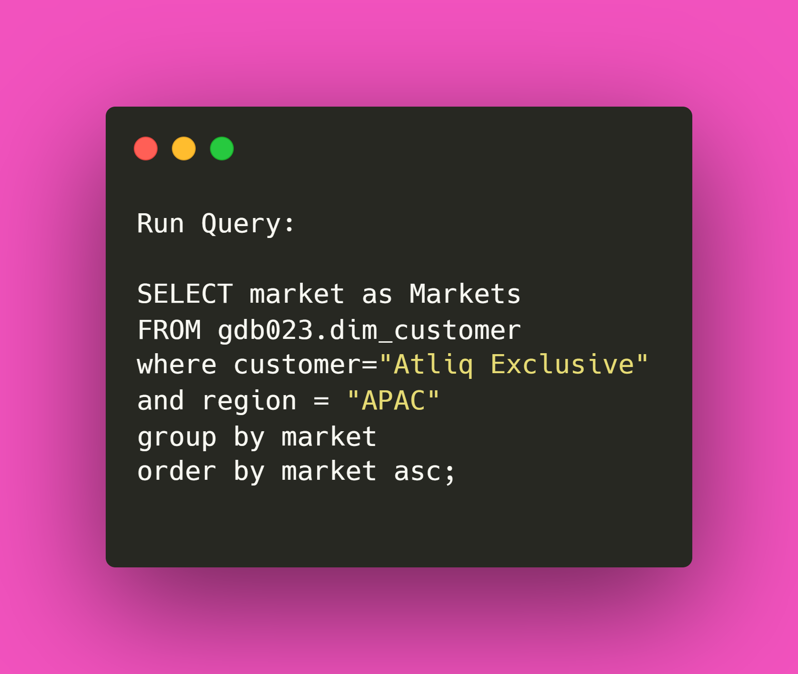
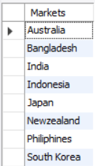


Provide the list of markets in which customer "Atliq Exclusive" operates its business in the APAC region.

Slide 5
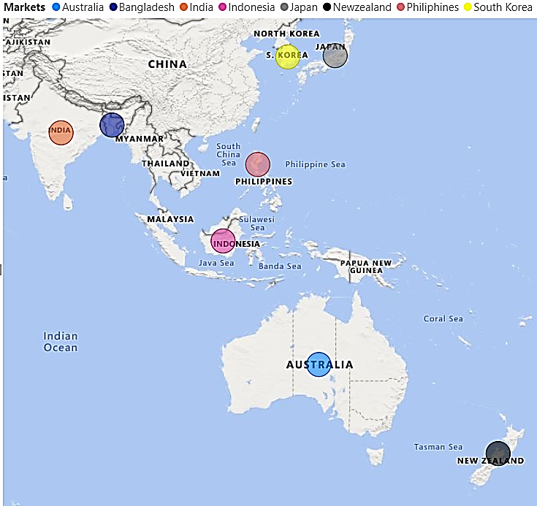

Provide the list of markets in which customer "Atliq Exclusive" operates its business in the APAC region.
Atliq Exclusive have captured their major markets in 8 shown countries covering APAC region.
Atliq Exclusive have their presence in total 27 countries.

Slide 6

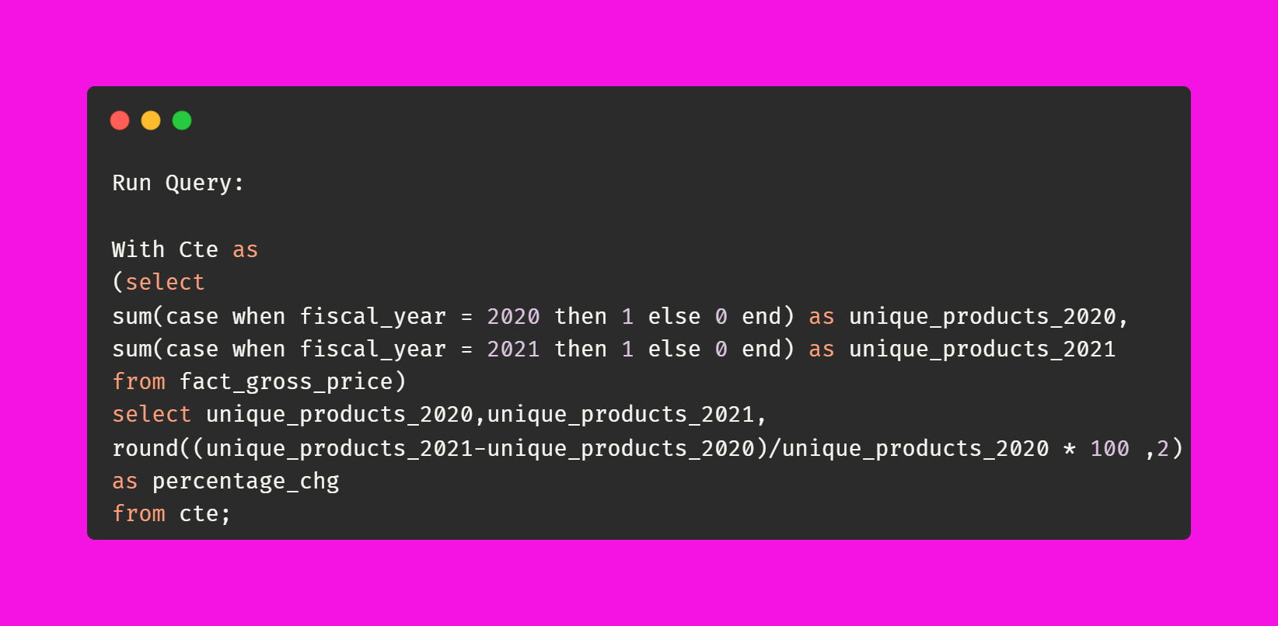

What is the percentage of unique product increase in 2021 vs. 2020? The final output contains these fields, unique_products_2020, unique_products_2021, percentage chg.

Slide 7
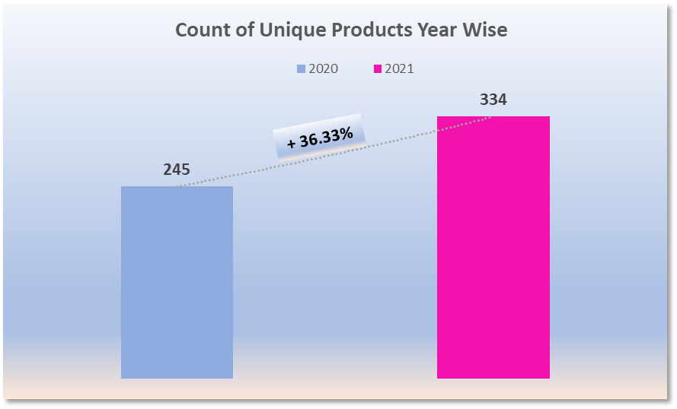
What is the percentage of unique product increase in 2021 vs. 2020? The final output contains these fields, unique_products_2020, unique_products_2021, percentage chg.
There is a significant increase in total unique products by 36.33% from 2020 to 2021
Total Unique Products in 2020 was 245 and this count increased to 334 in 2021.

Slide 8

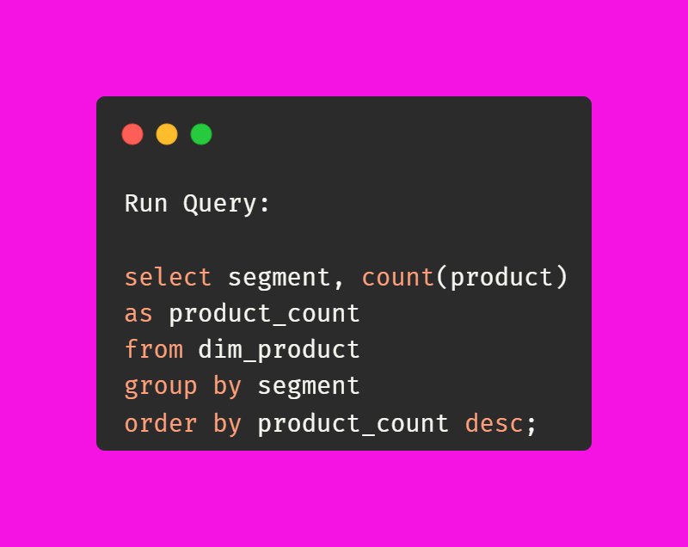
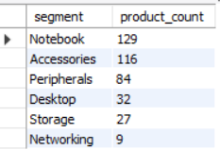
Provide a report with all the unique product counts for each segment and sort them in descending order of product counts. The final output contains 2 fields, segment, product count.

Slide 9
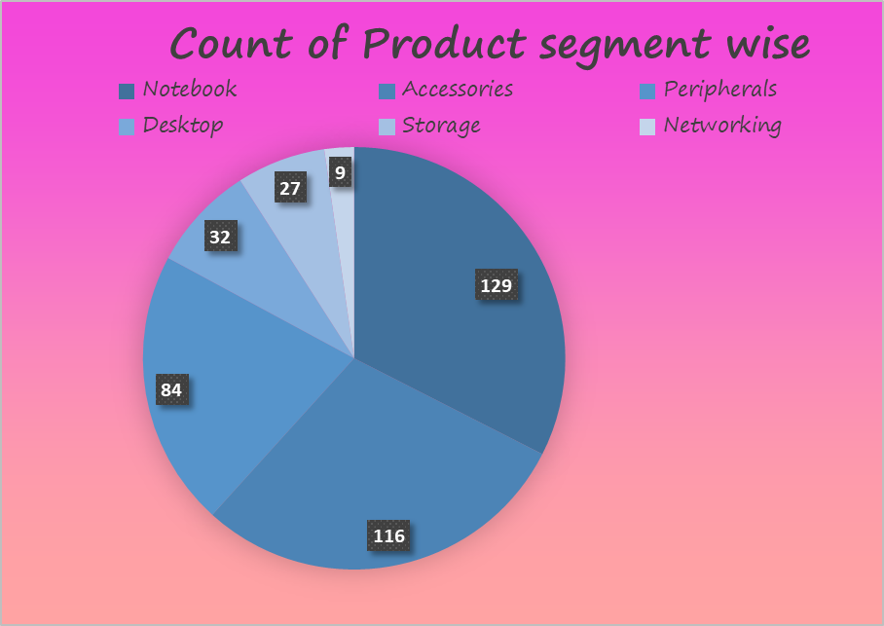
Provide a report with all the unique product counts for each segment and sort them in descending order of product counts. The final output contains 2 fields, segment, product count.
Total Unique Products are divided majorly in 5 segments
5 segments are named as Notebook,Accessories,Peripharals,Desktop,Storage,Networking
Notebook segment contributes maximum unique products with 129 of overall
Only 3 segment named Notebook, Accessories, Peripherals contributing more than 50% of total unique products

Slide 10

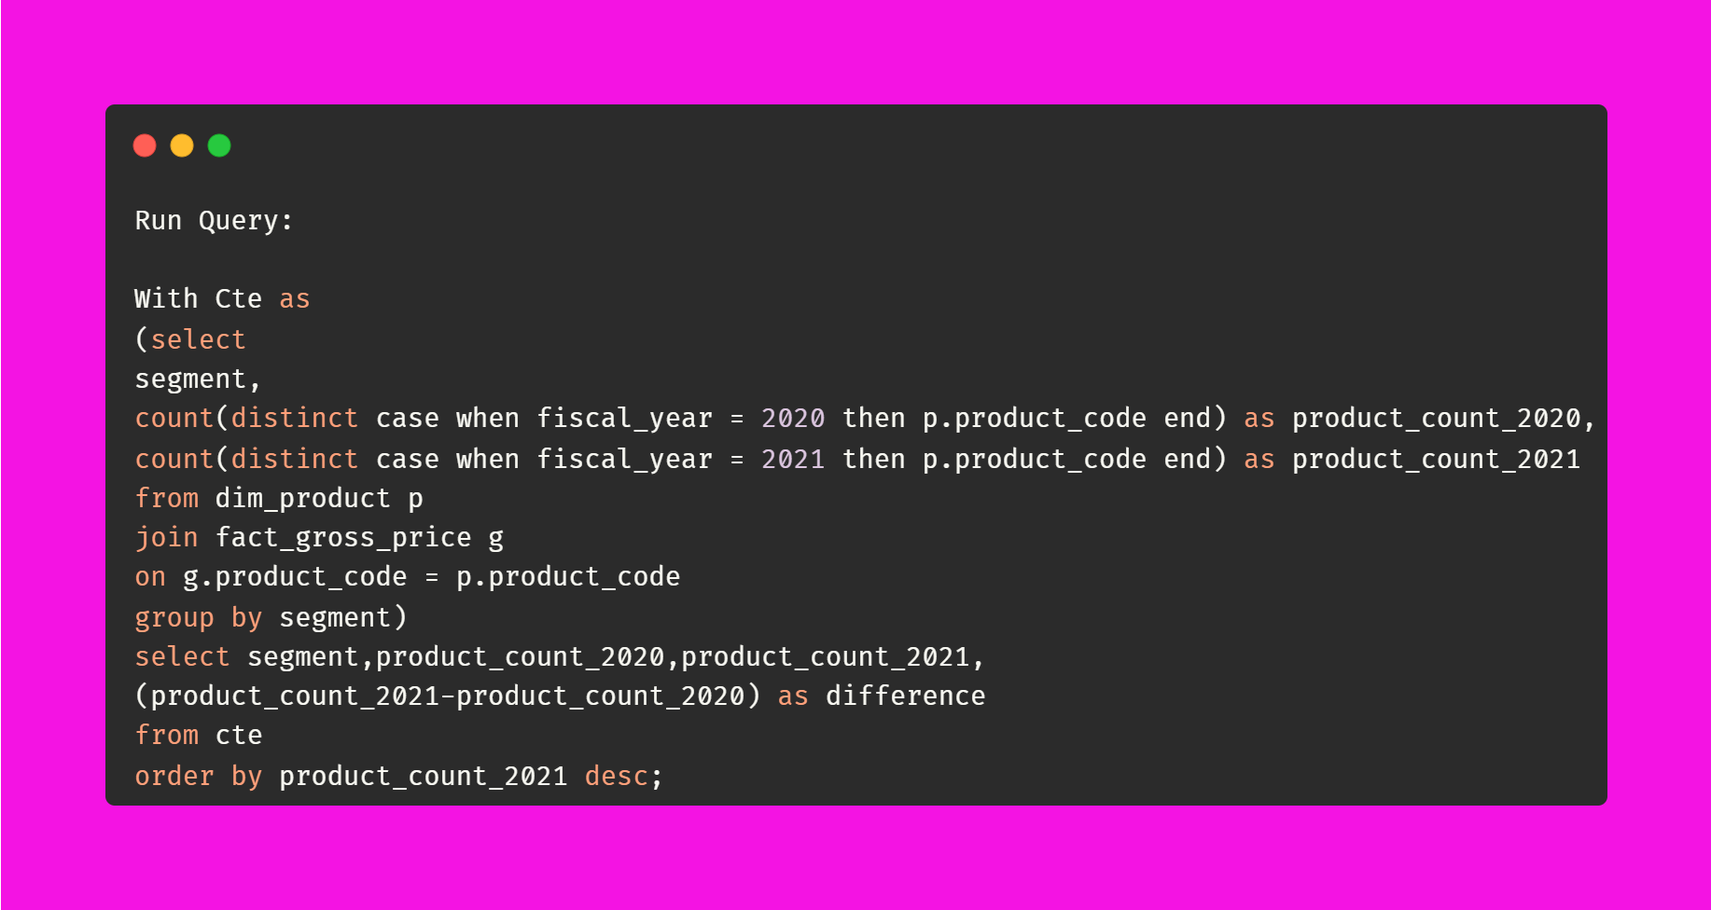
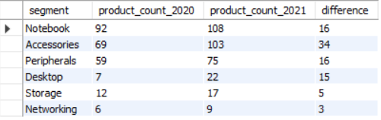
Follow-up: Which segment had the most increase in unique products in 2021 vs 2020? The final output contains these fields, segment product_count_2020 product_count_2021 difference

Slide 11
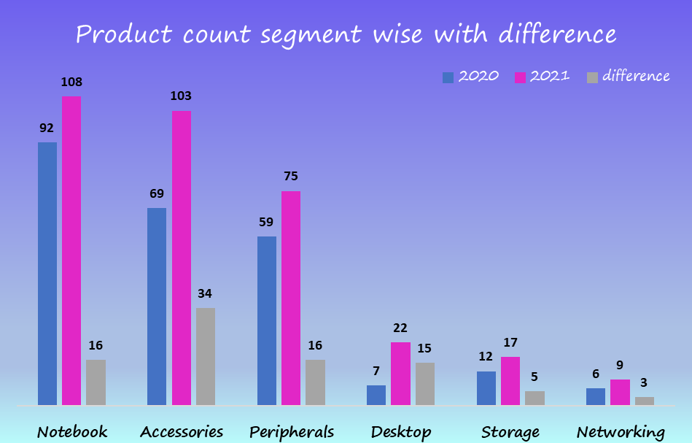
Follow-up: Which segment had the most increase in unique products in 2021 vs 2020? The final output contains these fields, segment product_count_2020 product_count_2021 difference
Accessories produced maximum increase in products in year 2021 with 34 quantity
Desktop segment tried well cope up to break their own record with 2X increase in product.
Storage produced minimum increase in products in year 2021 with only 17.24% as compared to last year

Slide 12

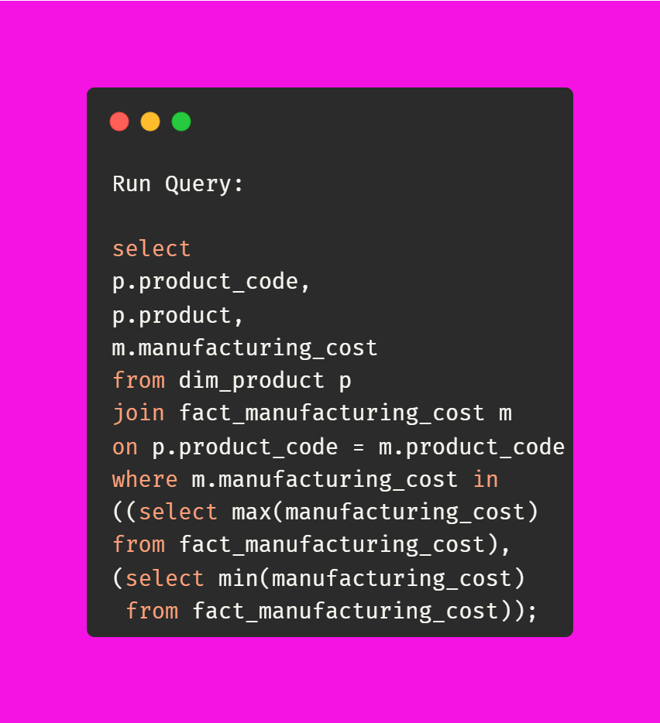

Get the products that have the highest and lowest manufacturing costs. The final output should contain these fields, product code product manufacturing cost

Slide 13
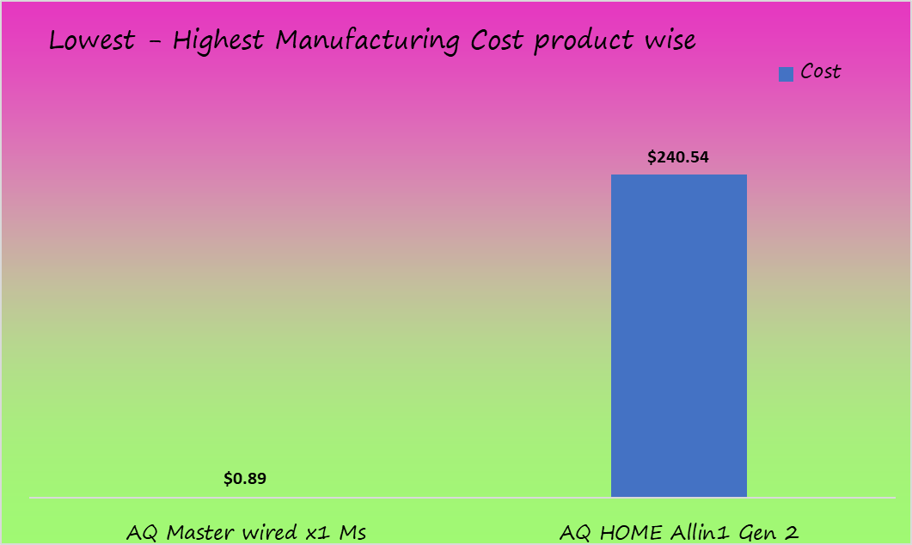
Get the products that have the highest and lowest manufacturing costs. The final output should contain these fields, product code product manufacturing cost
Allins Gen 2 has the highest manufacturing cost of $240.54.
Master wired x1 Ms has the lowest manufacturing cost of $0.89

Slide 14

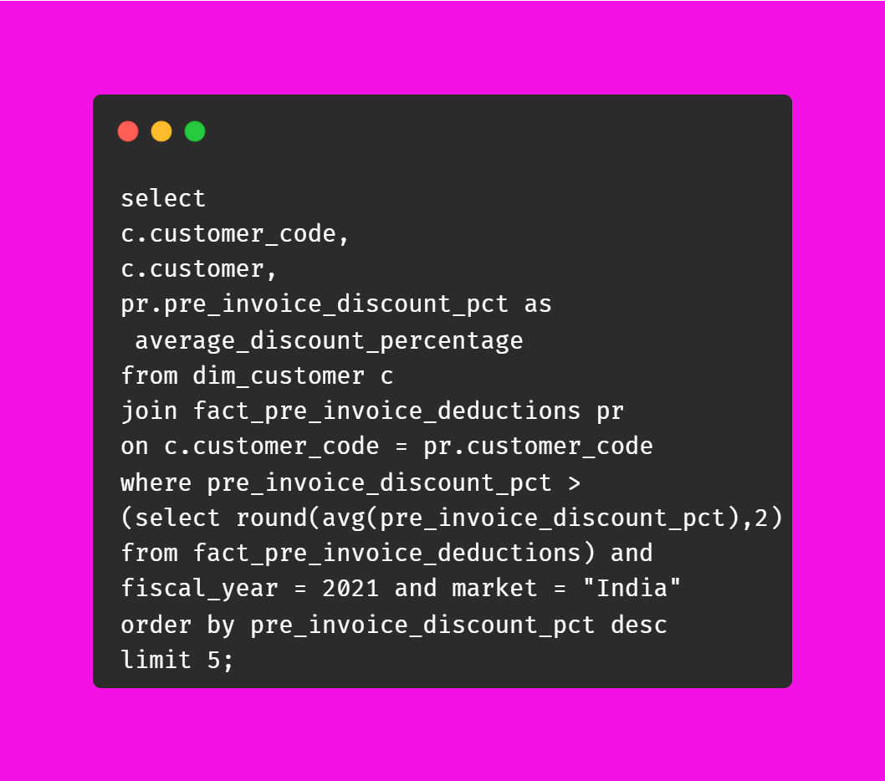
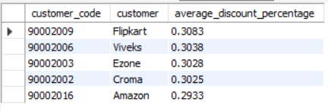
Generate a report which contains the top 5 customers who received an average high pre invoice discount % for the fiscal year 2021 and in the Indian market. The final output contains these fields, customer code customer average discount percentage.

Slide 15
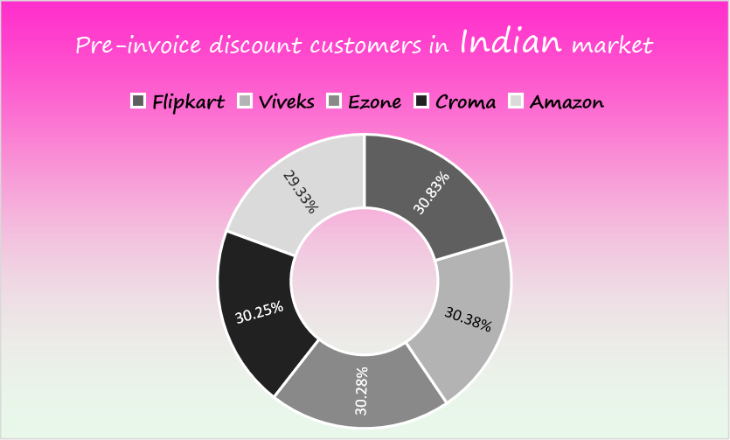
Generate a report which contains the top 5 customers who received an average high pre invoice discount % for the fiscal year 2021 and in the Indian market. The final output contains these fields, customer code customer average discount percentage.
Flipkart, Vivek's, Ezone,
Croma, Amazon are the top 5 customers in Indian market

Slide 16

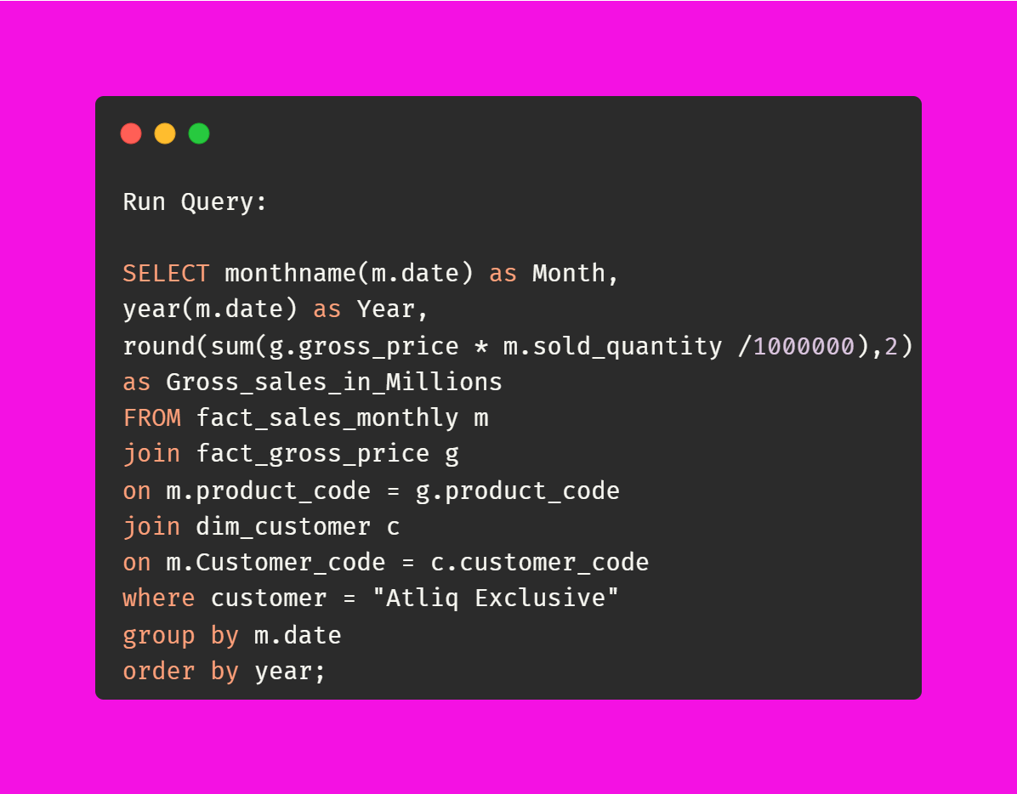
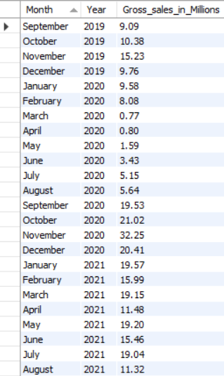
Get the complete report of the Gross sales amount for the customer “Atliq Exclusive” for each month. This analysis helps to get an idea of low and high-performing months and take strategic decisions. The final report contains these columns: Month Year Gross sales Amount

Slide 17
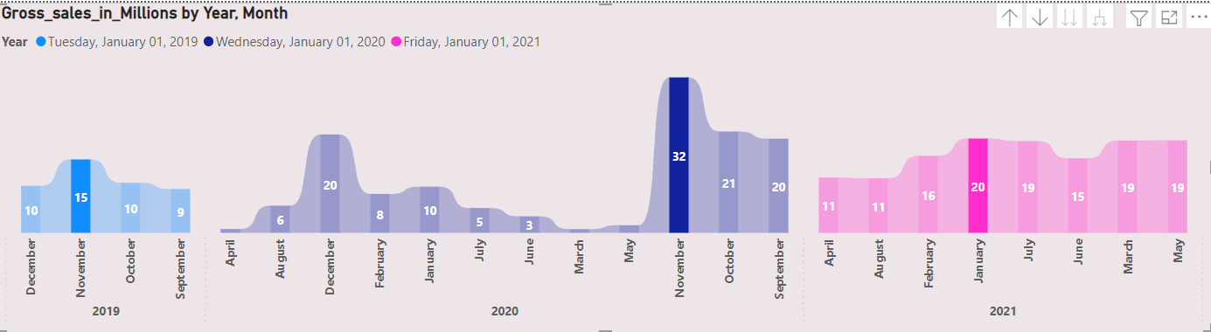
Get the complete report of the Gross sales amount for the customer “Atliq Exclusive” for each month. This analysis helps to get an idea of low and high-performing months and take strategic decisions. The final report contains these columns: Month Year Gross sales Amount.
November was the highest Gross sales month in year 2019 with 15$ million
November was the highest Gross sales month in year 2020 with 32$ million
January was the highest Gross sales month in year 2021 with 20$ million

Slide 18

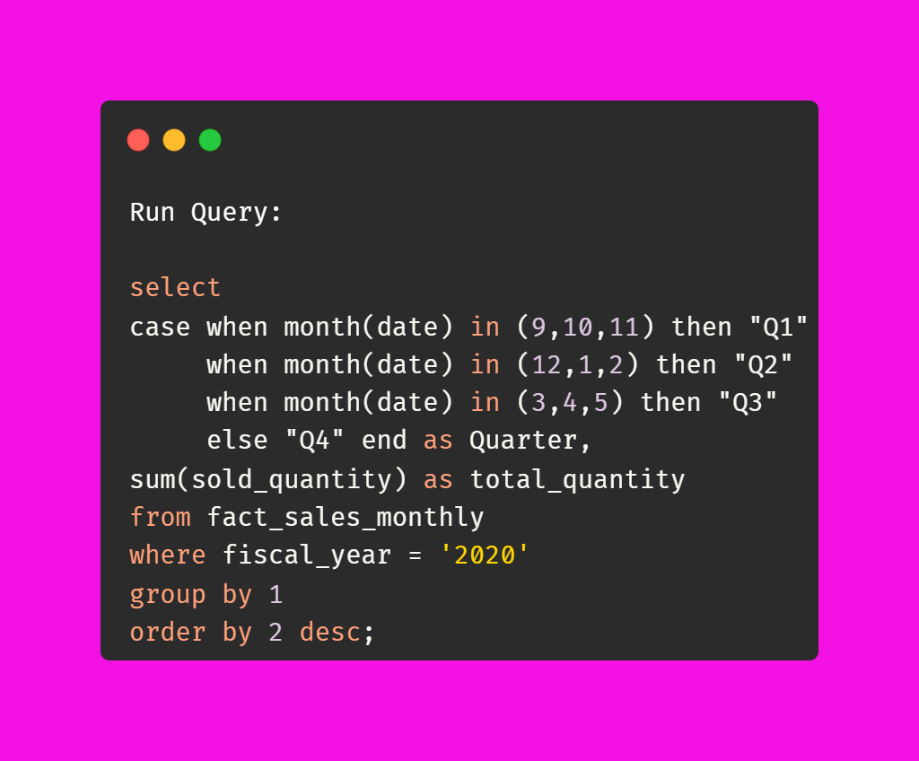
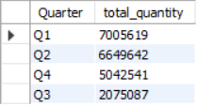
In which quarter of 2020, got the maximum total sold quantity? The final output contains these fields sorted by the total sold quantity, Quarter total sold quantity.

Slide 19
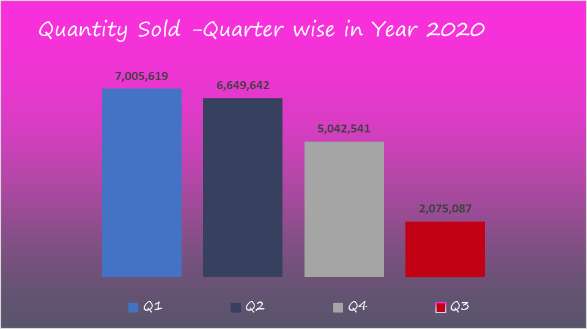
In which quarter of 2020, got the maximum total sold quantity? The final output contains these fields sorted by the total sold quantity, Quarter total sold quantity.
Maximum Quantity sold in Q1 with 7.01 million
Minimum Quantity sold in Q3 with 2.01 million due to pandemic hit.
Selling Quantity began to increase in Q4 post pandemic

Slide 20

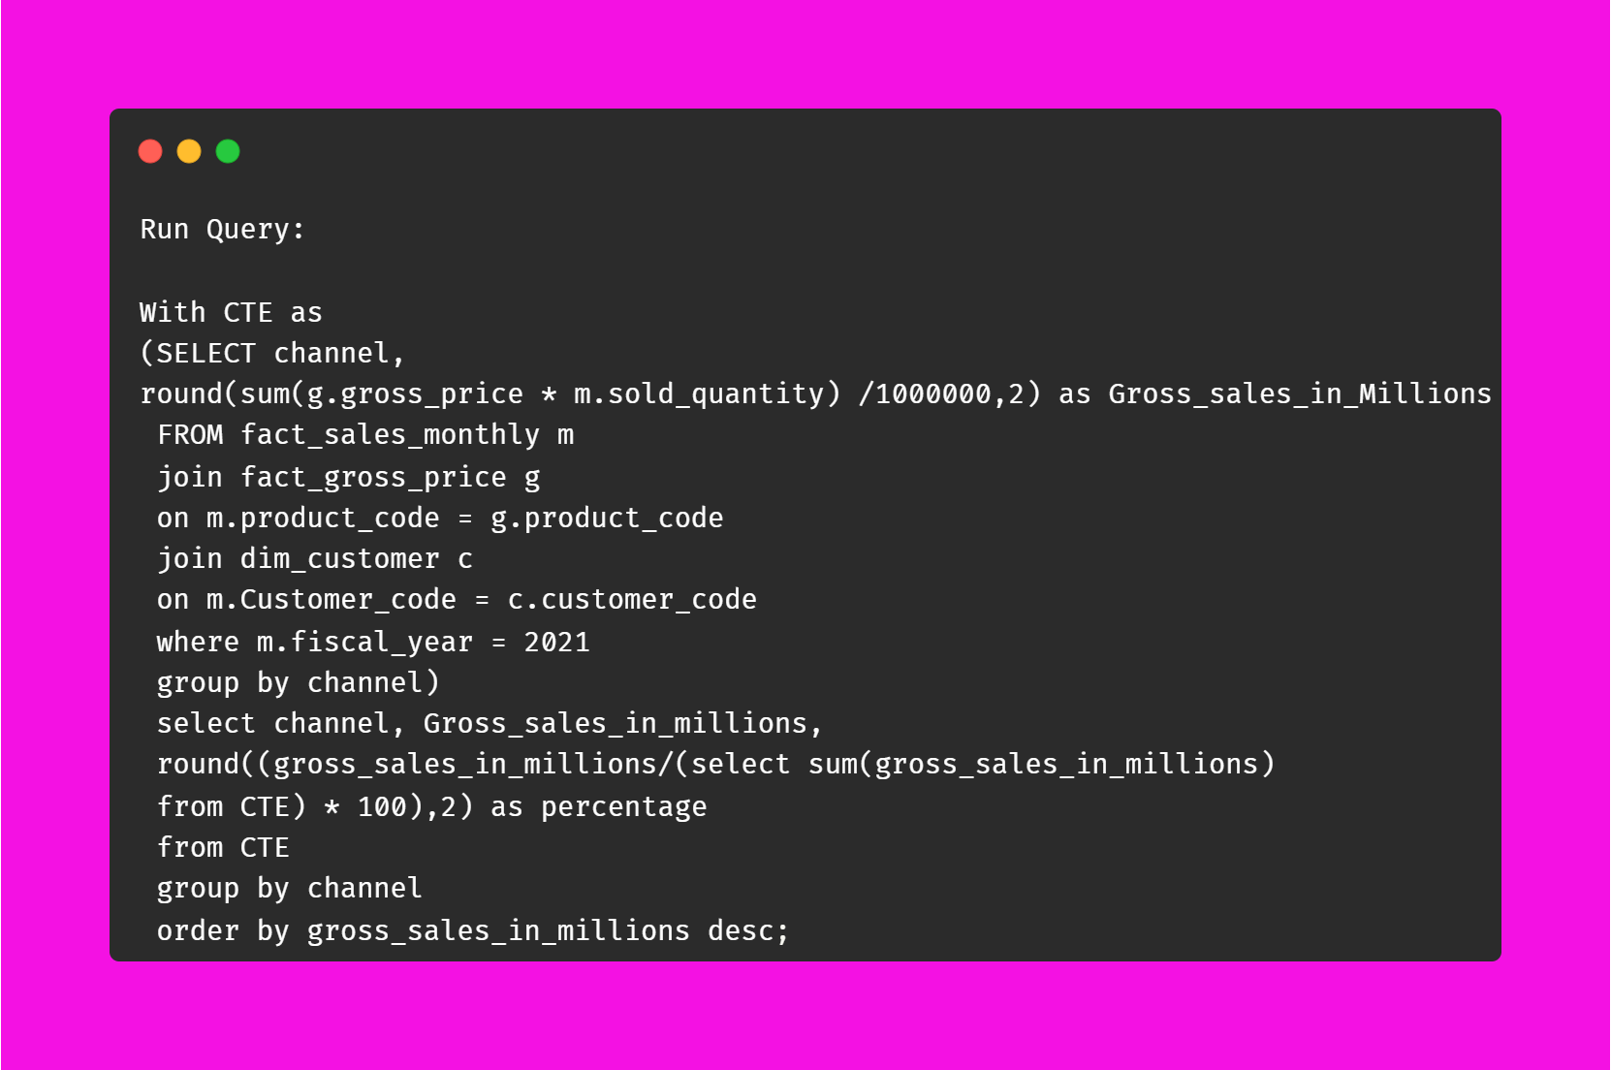
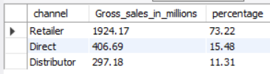
Which channel helped to bring more gross sales in the fiscal year 2021 and the percentage of contribution? The final output contains these fields, channel gross sales in million , percentage

Slide 21
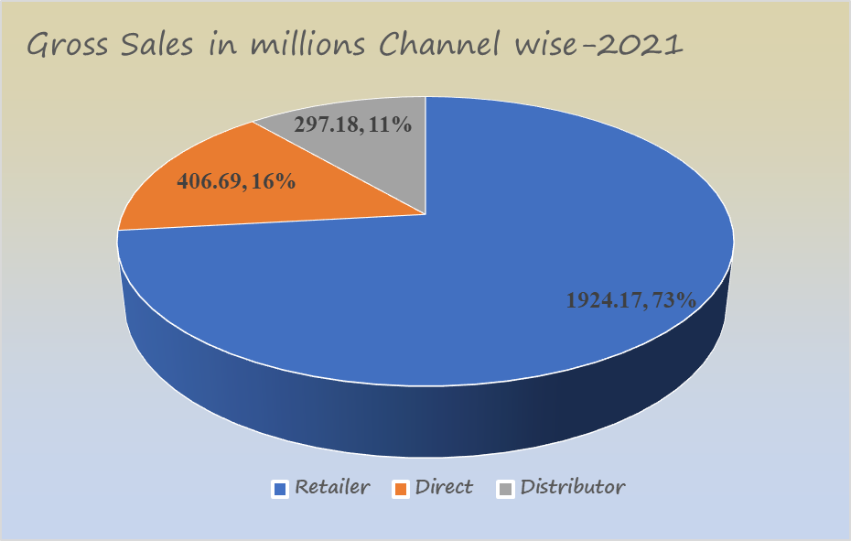
Which channel helped to bring more gross sales in the fiscal year 2021 and the percentage of contribution? The final output contains these fields, channel gross sales in million , percentage
Maximum Contribution in Gross sales is by Retailers.
Distributor is contributing only 11% in gross sales

Slide 22

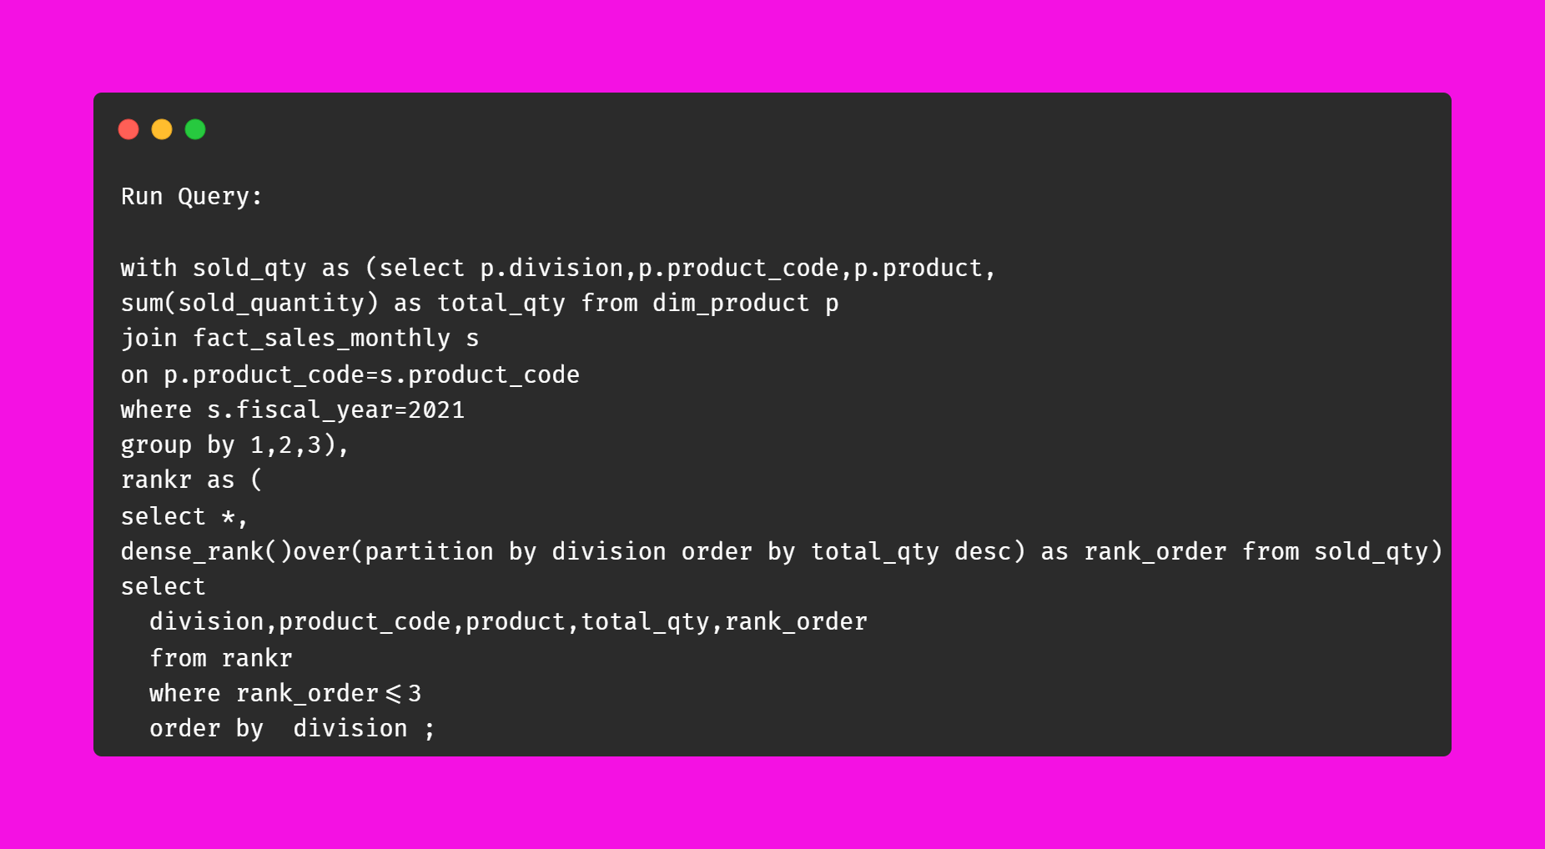
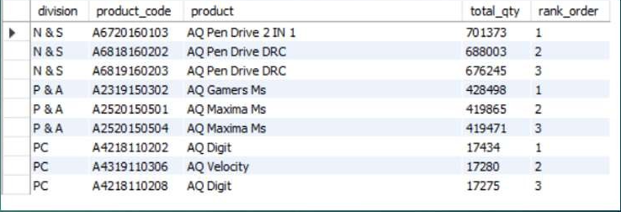
Get the Top 3 products in each division that have a high total sold quantity in the fiscal year 2021? The final output contains these fields, division product code, product total sold quantity, rank order

Slide 23
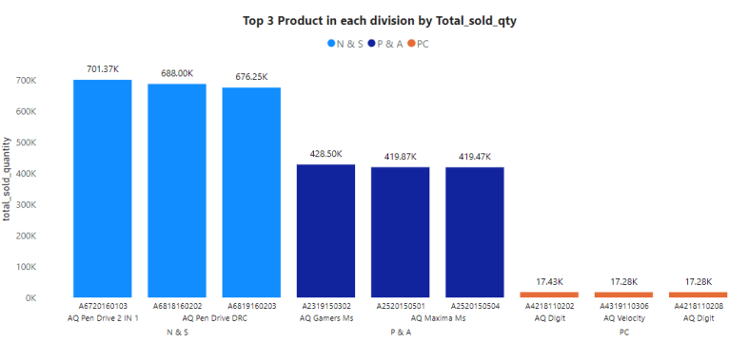
Get the Top 3 products in each division that have a high total sold quantity in the fiscal year 2021? The final output contains these fields, division product code, product total sold quantity, rank order
AQ Pen Drive 2 IN 1
,AQ Gamers MS,
AQ Digit are the highest selling product in N& S,
P& A and PC region
Sales of N& S region is highest as compared to other regions in 2021.

Slide 24

Thank you for your time

